Slide 1
PHYSICAL PROPERTIES OF AMINES
ODOUR
PHYSICAL STATE
SOLUBILITY
BOILING POINT

Slide 2
STATE AND ODOUR
The lower aliphatic amines are gaseous in nature. They have a fishy smell.
Primary amines with three or four carbon atoms are liquids at room temperature whereas higher ones are solids.
Aniline and other aryl amines are generally colourless. However, they get coloured when we store them in open due to atmospheric oxidation.

Slide 3
SOLUBILITY
Lower aliphatic amines can form hydrogen bonds with water molecules. Therefore, such amines are soluble in water.
Increase in the size of hydrophobic alkyl part increases the molar mass of amines. This usually results in a decrease in its solubility in water.
Higher amines are insoluble in water. Organic solvents like alcohol, benzene and ether readily dissolve amines.
Alcohols have higher polarity as compared to amines and hence, they form stronger intermolecular hydrogen bonds.

Slide 4
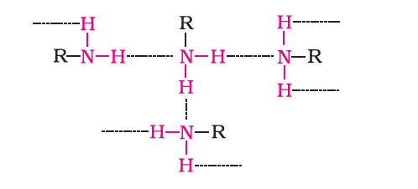
BOILING POINT
Primary and secondary amines are engaged in intermolecular association due to hydrogen bonding between nitrogen of one and hydrogen of another molecule.
This intermolecular association is more in primary amines than in secondary amines as there are two hydrogen
atoms available for hydrogen bond formation in it.
Tertiary amines do not have intermolecular association due to the absence of hydrogen atom available for hydrogen bond formation.
Therefore, the order of boiling points of isomeric amines is as follows: Primary > Secondary > Tertiary

Slide 11
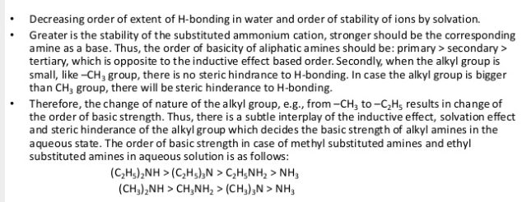

Slide 14
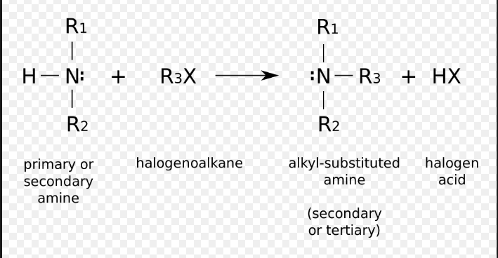
ALKYLATION

Slide 16
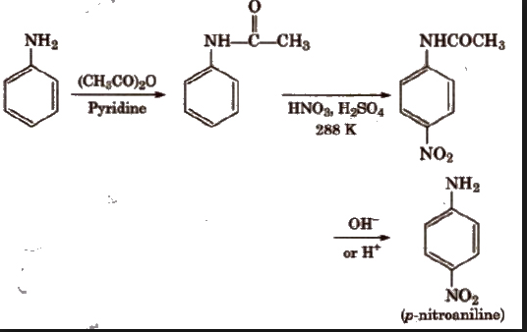
ACYLATION OF AROMATIC AMINE
N-Phenylethanamide
Acetanilide

Slide 17
CARBYLAMINE REACTION

Slide 18
REACTION WITH NITROUS ACID

Slide 19
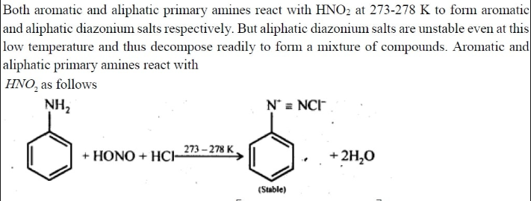
REACTION OF ANILINE WITH NITROUS ACID
BENZENE DIAZONIUM SALT

Slide 20
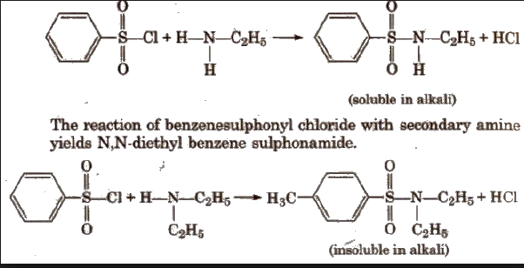
REACTION OF ARYLSULPHONYL CHLORIDE
HINSBERG’S REAGENT
N-ETHYL SULPHONAMIDE

Slide 21
ELECTROPHILIC SUBSTITUTION REACTION
BROMINATION
NITRATION
SULPHONATION

Slide 22
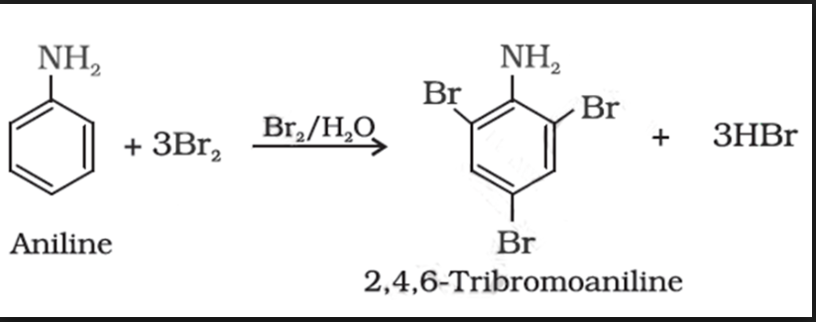
BROMINATION

Slide 23
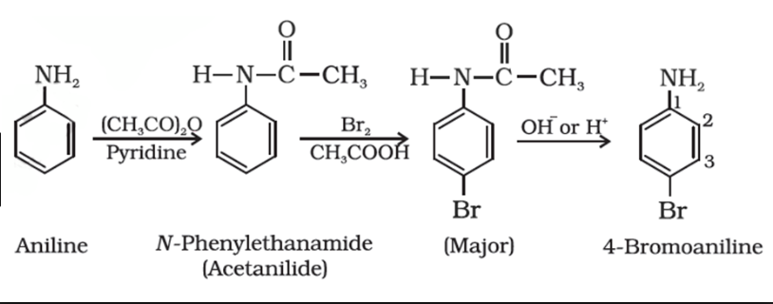
TO CONTROL THE ACTIVATING EFFECT OF NH2 IN ANILINE ACYLATION IS DONE AND THE PRODUCT OBTAINED WILL BE HYDROLYSED TO GET BROMINE SUBSTITUTED ANILINE

Slide 24
NITRATION
IN THE ACIDIC MEDIUM ANILINE IS PROTONATED TO FORM ANILIUM ION WHICH WILL DIRECT THE NO2 GROUP TO META POSITION TO CONTROL THIS ACETYLATION IS DONE FOLLOWED BY NITRATION WITH HNO3 AND H2SO4 AND HYDROLYSIS USING ACID OR BASE

Slide 25
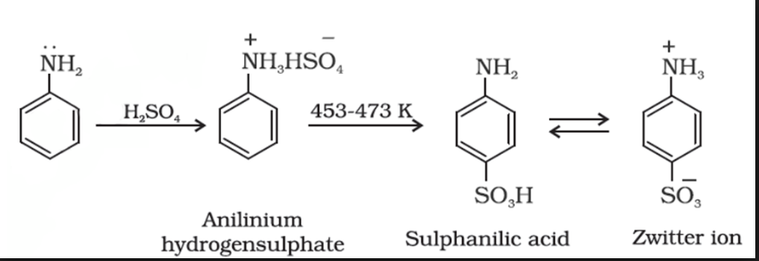
SULPHONATION

